Slide 1
D.Eco Application
Drury University – CS Senior Seminar
Morgan Brown, Faisal Alsabhan, Cory Harris, Cyler Gannon, Kylie Pfaff

Slide 2
 | Sprint 2 Requirements | Sprint 2 Completion
View 21 Trees on Campus | X | X
View/Read specific trees | X | X
Access Menu | X
Search Specific Trees | X
21 Tree Tour | X
Manage Trees | X
AWS Virtual Private Cloud (EC2 instance, RDS, manage security and trafficking) |  | X
Create PHP script in EC2 to get JSON object from RDS |  | X
Auto layout for all iOS and Android devices |  | X
Updated design (header and theme) |  | X
Added user location button (iOS) |  | X
Faster performance |  | X

Slide 3
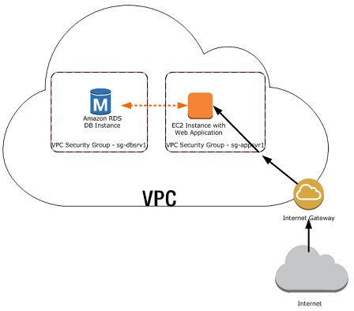
AWS Virtual Private Cloud
http://docs.aws.amazon.com/AmazonRDS/latest/UserGuide/USER_VPC.Scenarios.html

Slide 4
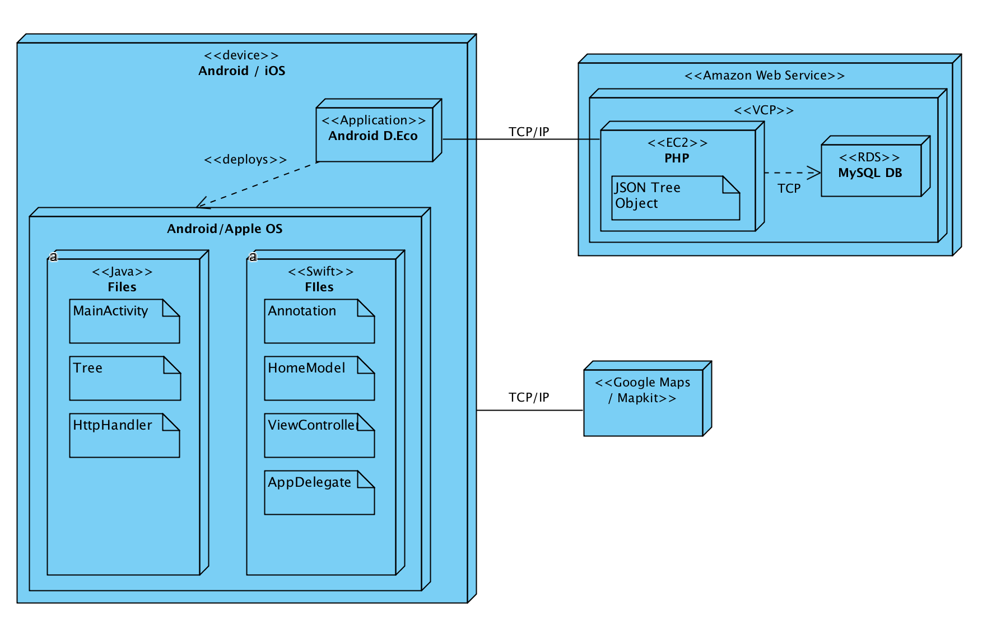
Architecture Diagram

Slide 5
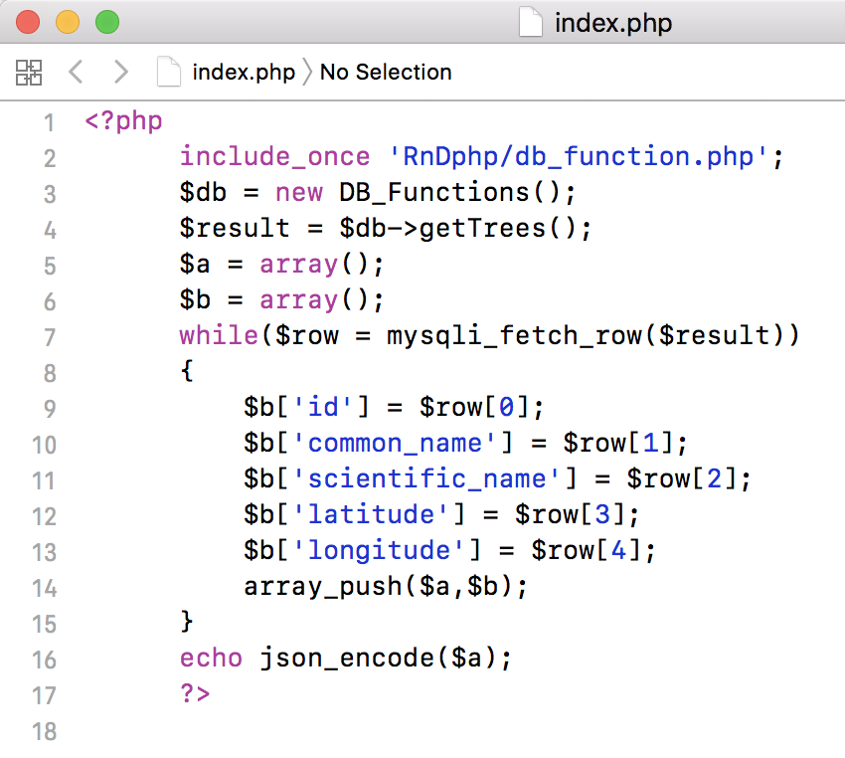
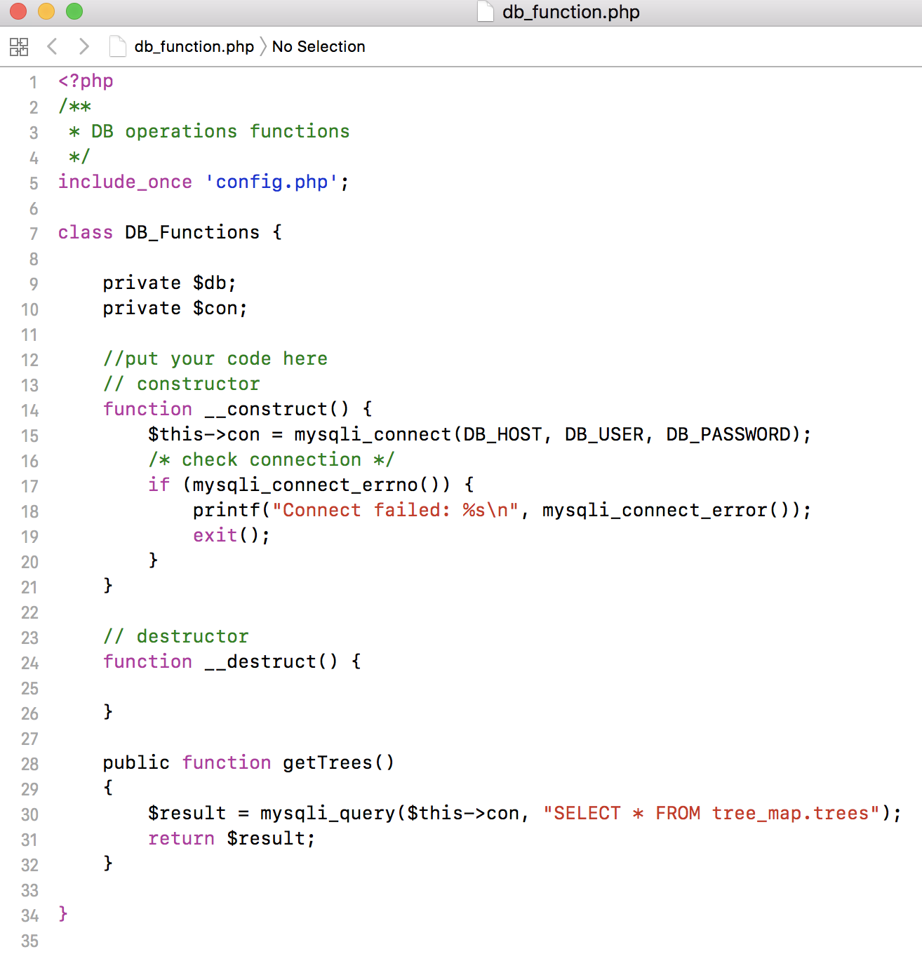
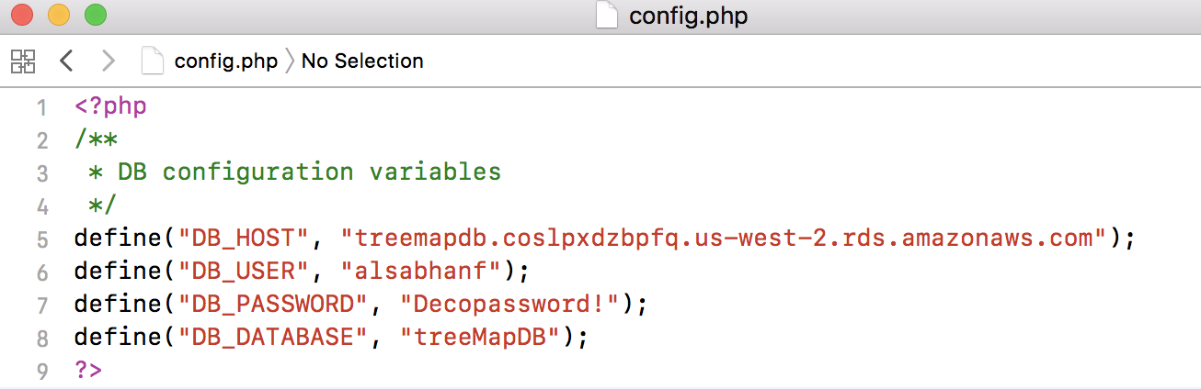
PHP Script

Slide 6
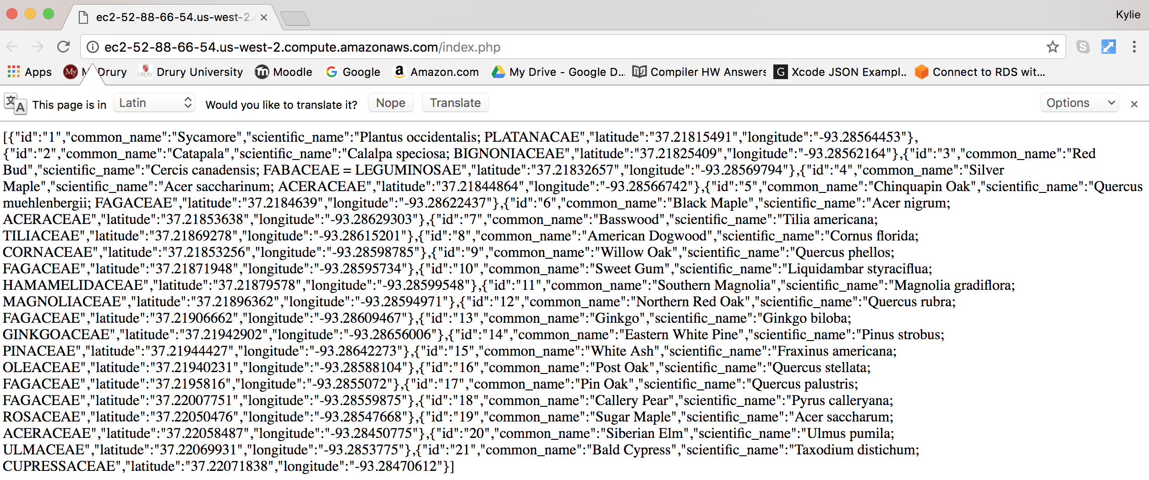
JSON Object

Slide 7
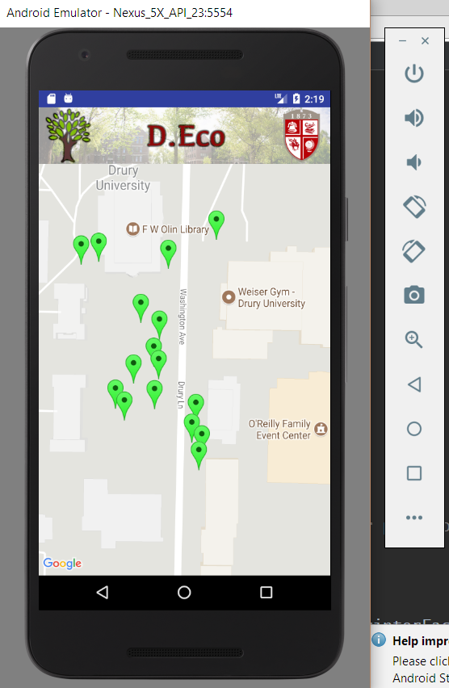
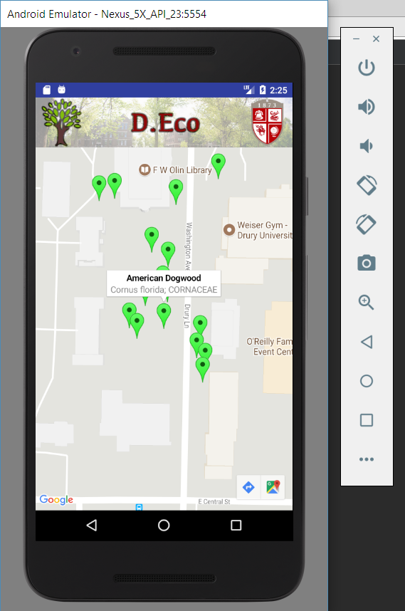
Android
Java
Google Maps API
Annotation Points
Current Location
Standard Map View
Auto layout

Slide 8
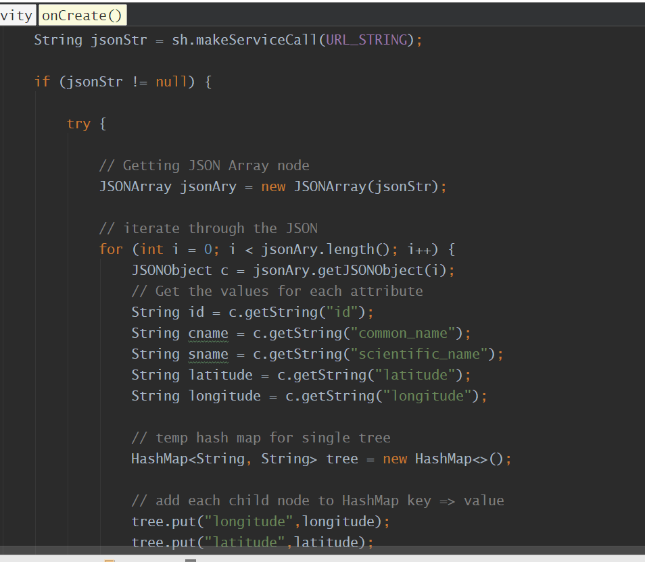
Android Code – Getting JSON object

Slide 9
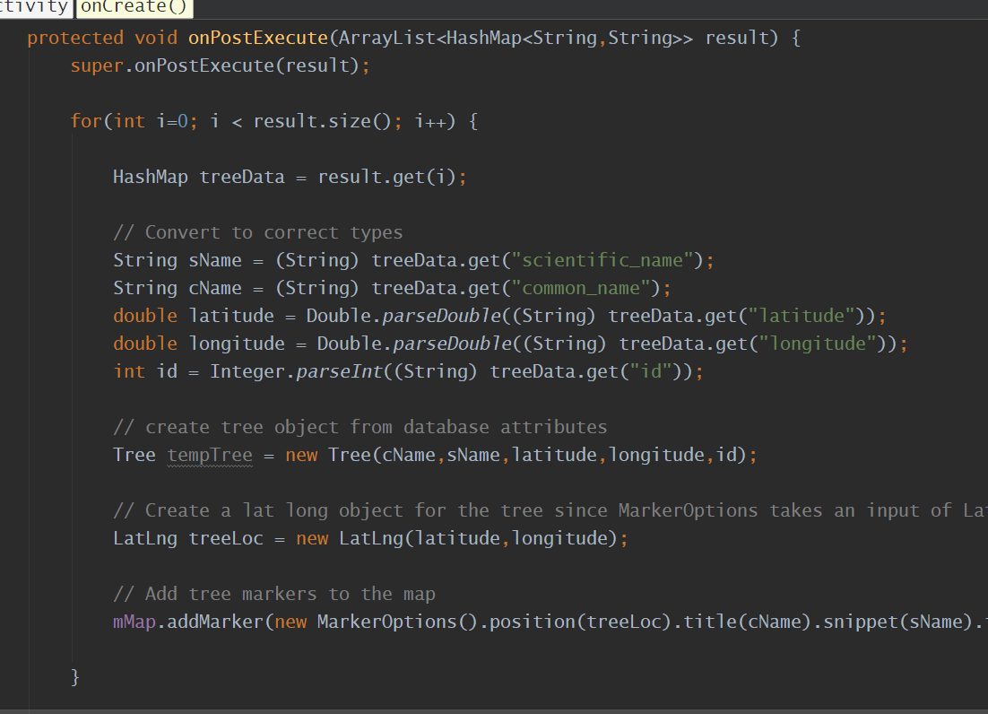
Android Code – Making Annotation Points

Slide 10
iOS
Swift
iOS MapKit
Annotation points
Core Location
User current location
Refresh user location
Auto layout
Standard / Hybrid Map View

Slide 11
Next Sprint Requirements
Splash Screen
Access Menu
21 Tree Tour

